Slide 1
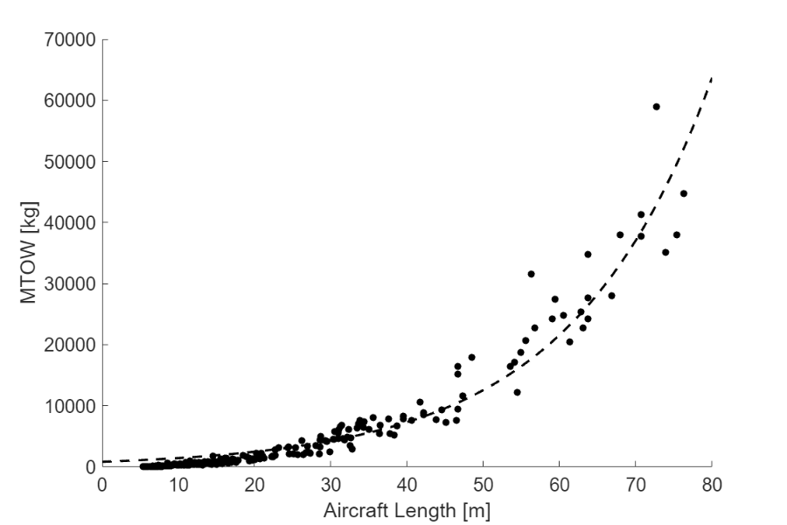

Trendline: $8426 exp\left(0.0541 L_{a/c}\right)$
Airbus A380
Boeing 747
Lockheed C-130
Diamond DA-40

